Slide 1
Practices on the development of visual aids such as posters, charts, pamphlets, flash cards and graphs
Major Objectives of Visual Aids in Teaching
Clarifying Complex Concepts
Enhancing Memory Retention
Supporting Diverse Learning Styles
Encouraging Active Participation
Integrating with Lesson Plans

Slide 2


Slide 3


Slide 4
Aspect | Posters | Pamphlets
Size | Typically larger, single-sheet format | Folded document, usually multiple pages
Content | Minimal text with bold visuals | Detailed information with more text
Purpose | Capture attention quickly (advertising, announcements) | Educate or persuade on a specific topic
Audience Engagement | Designed for quick viewing in public spaces | Targeted distribution for deeper understanding
Cost | Generally less expensive to produce | Often more costly due to extensive printing needs

Slide 5
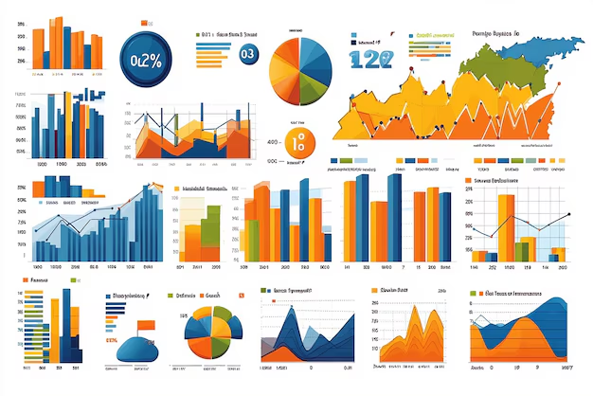

Slide 6
Shows chart to documentations.
Bar Chart
Line Graph
Pie Chart
Scatter Plot
Area Chart
Histogram
Box Plot
Heatmap
Bubble Chart
Gantt Chart

Slide 7
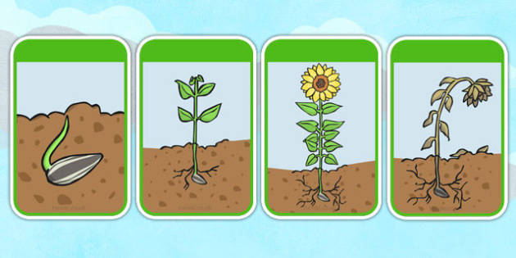

Slide 8
